Slide 1
ANNOUNCEMENTS
December 2020

Slide 2
Holiday Schedule
Last Day of School
December 23
Holiday Recess
December 24 – January 3
Schools Reopen (Virtual Learning)
January 4

Slide 3
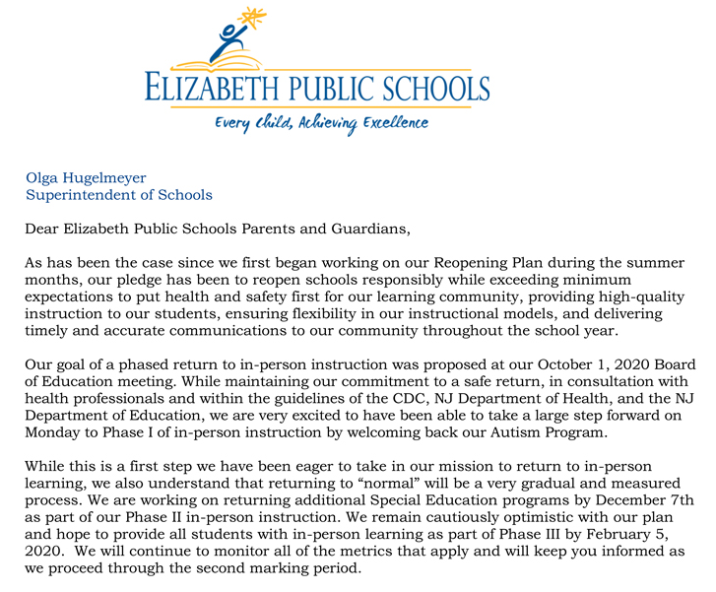
Virtual Learning Update
Letter to Parents November 10, 2020 – Virtually Learning through February 5, 2021.
Parent notification by Monday, January 25, 2021 with information regarding the status of COVID in our community.

Slide 4
Virtual Learning Update
Factors to take into consideration:
COVID Activity Report published by New Jersey Department of Health Understanding that COVID-19 may impact certain areas of the state differently, NJDOH provides weekly information on COVID-19 transmission at the regional level, characterizing risk as low (green), moderate (yellow), high (orange), and very high (red). Currently Union County is High Risk and Elizabeth is Very High Risk. Very High Risk requires full remote learning.
Consultation with Local health officer on guidance regarding COVID-19 in our municipality that can inform our local planning and response actions

Slide 5
New Initiatives
Amistad Mandate
This month we are continuing our partnership with Dr. Davida Lindsay-Harewood. This extended contract will focus on professional development for our principals and social studies teachers to inform them of the curricular enhancements just completed and to also clarify for them the intent of the Amistad Mandate as it relates to future work being proposed. The work of the Amistad Collaborative continued, and a virtual meeting is scheduled for December 22, 2020 to capture the work just completed and plans moving forward.

Slide 6
New Initiatives
Virtual Leading to the Future
The Leading to the Future Program will occur virtually this year and include STEM-minded students from Thomas Jefferson Arts Academy, Admiral William F. Halsey, Jr., Health and Public Safety Academy, John E. Dwyer Technology Academy and Thomas E. Edison Career & Technical Academy. We are grateful to Michelle Doran-McBean and her entire team at Future City for their commitment in maintaining this program during the pandemic. This year’s workshops will include three sessions from January through March 2021 and focus on overcoming obstacles, career planning and the concepts of resilience and sustainability.

Slide 7
New Initiatives
Virtual Student Success Center
Elizabeth Public Schools and Make the Road New Jersey
has partnered once again to provide a Student Success
Center at Admiral William F. Halsey, Jr. Health and Public Safety Academy. Beginning January 4, 2021, The Virtual Student Success will be open daily from 2:00pm to 6:30pm, Monday through Friday. During that time, students may sign up for appointments with the Student Success Center to meet with one of the student College Ambassadors, supervised by the SSC Coordinator. College Ambassadors will conduct outreach to students, prepare pre-recorded videos on the college application process, and support students with college and financial aid applications. They will also host financial aid clinics and SAT practice tests, in addition to virtual college tours. During that time, the SSC Coordinator will also hold supervision meetings with College Ambassadors to provide continuing education, debrief events/workshops and prepare for upcoming events/workshops. There will also be workshops open to parents during this time.

Slide 8
New Initiatives
Virtual Point of Entry Program for K-8
Our students will benefit from a virtual Point of Entry Program starting on January 11, 2021 through June 11, 2021 on Tuesday through Thursday in the afternoon. The focus is on our new entrants, the programs aims to develop English-language proficiency skills, share remote learning experiences and address social-emotional learning concerns. Our Bilingual Psychologist will be working with both teachers in the program, students and parents.

Slide 9
New Initiatives
Virtual Bilingual Achievement Strategies Program for 9-12 English Language Learners
Our high school English Language Learner students will benefit from a virtual Point of Entry Program starting on January 11, 2021 through June 10, 2021 on Monday through Thursday in the afternoon. The focus is on developing English-language proficiency skills, mathematical skills, share remote learning experiences and address social-emotional learning concerns. Our Bilingual Psychologist will be working with both teachers in the program, students and parents.

Slide 10
New Initiatives
Partnership with The College of New Jersey for the Expanding Access to Computer Science Education
Elizabeth Public Schools has partnered with the College of New Jersey to provide free computer science professional development for our teachers in district for a twelve-month period. The intent is to expand access opportunities and enable our teachers to participate in high-quality professional learning experiences in computer science education.

Slide 11
New Initiatives
Virtual Interscholastic Athletic Programs
The New Jersey State Interscholastic Athletic Association authorized school districts to operate a Virtual Winter Interscholastic Athletic Programs beginning on December 14, 2020 for Boy and Girls Basketball and Bowling.

